Slide 1
Process controll –Hyperdrive Project
Joachim Raffaele Bono Elise Høimyr Séverine Oppliger
Group D

Slide 2
Demo
TODO: insert a video in case it doesn’t work

Slide 3





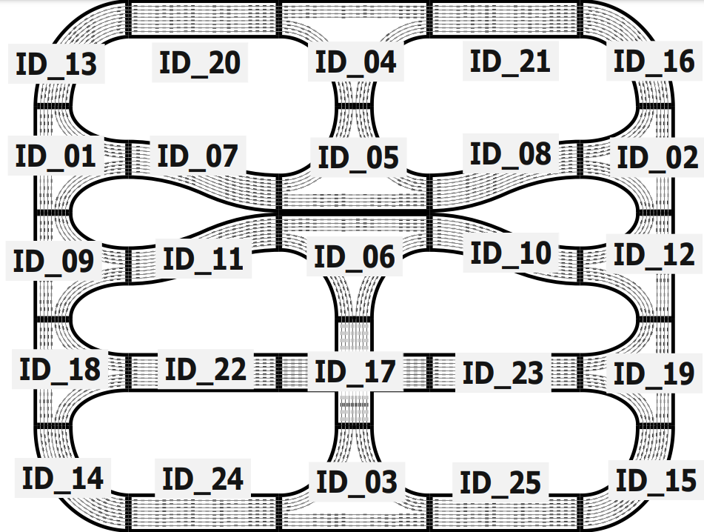






System overview
publication
MQTT broker
On
Off
MQTT
MQTT
MQTT
Emergency
MQTT
subscription

Slide 4
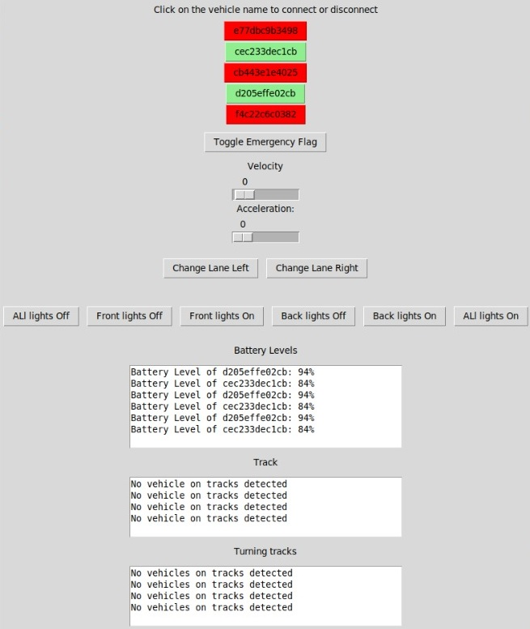
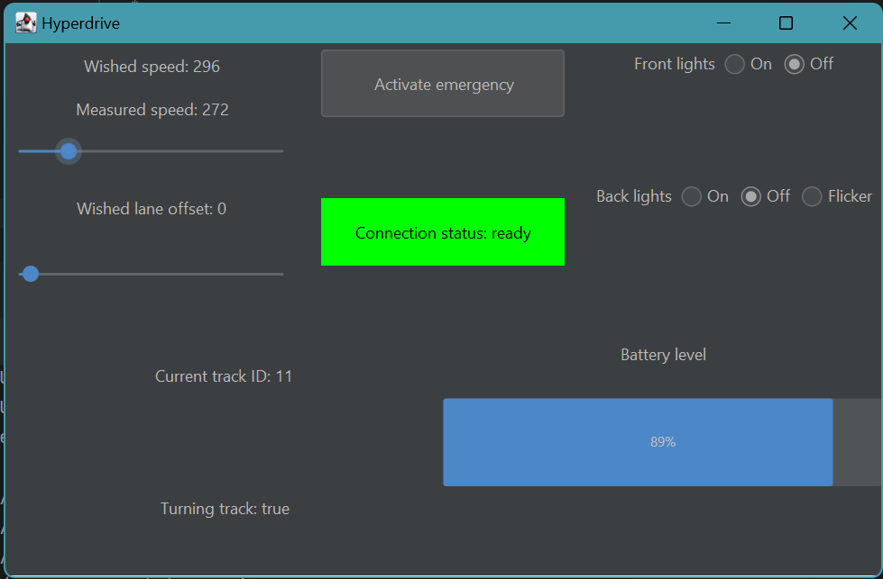

GUI
Python (uses Tkinter)
Java (uses Swing)

Slide 5








Java Implementation (1/2) - Classes
Utilities
MqttHandler
MessageHandler
MessageListener
Manage communication between the application and the MQTT broker
Manage MessageListeners and handle incoming messages (store them in the appropriate MessageListener instance)
Recipient of the last message published in a given topic to which we are subscribed
Main
MVC architecture
Connect to vehicle through MQTT broker
Steering thread
SteeringModel
SteeringController
SetupVehicleManager
Control speed, lane offset, lights + (de)toggle emergency stop
Broker discovering ?
If no, «discover»: true
Vehicle among recognized vehicles ?
Connect vehicle
Is vehicle ready ?
View
VehicleInfoModel
VehicleInfoController
VehicleInfo thread
Retrieve info about connection status, measured speed, trackId, battery level + estimate if turning

Slide 6






Java Implementation (2/2) – MVC
Steering thread
Wished speed
Wished lane offset
Front lights / Back lights
Emergency status
On
Off
MQTT
Emergency
Observable
Observer
Model
Controller
View
VehicleInfo thread
Connection status
Measured speed
Turning status
Current track id
Battery level
MQTT
Observable
Observer

Slide 7
Difficulties
GUI:
Sliders: action (publish) at each step while we move it (not only when mouse realised)
→ fixed on Java but seems impossible on Python
Battery status: is not really reliable (shows 80 when battery is fast empty)
Concurrent programming: no Java interaction with MQTT emergency topic
→ no external emergency activation detected

